Slide 1
AI - Popular Search Algorithms
Mr. Ali Haider
Lab Instructor
Institute of Management Sciences, Peshawar.

Slide 2
Searching
Searching is the universal technique of problem solving in AI.
There are some single-player games such as tile games, Sudoku, crossword, etc.
The search algorithms help you to search for a particular position in such games.

Slide 3
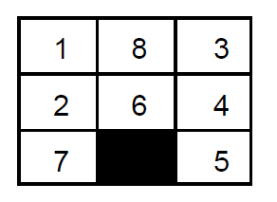
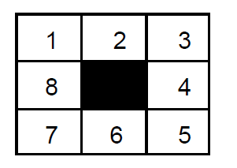
Single Agent Pathfinding Problems
The games such as 3X3 eight-tile, 4X4 fifteen-tile, and 5X5 twenty four tile puzzles are single-agent-path-finding challenges.
They consist of a matrix of tiles with a blank tile. The player is required to arrange the tiles by sliding a tile either vertically or horizontally into a blank space with the aim of accomplishing some objective.
The other examples of single agent pathfinding problems are Travelling Salesman Problem, Rubik’s Cube, and Theorem Proving.
Initial State
Final State

Slide 4
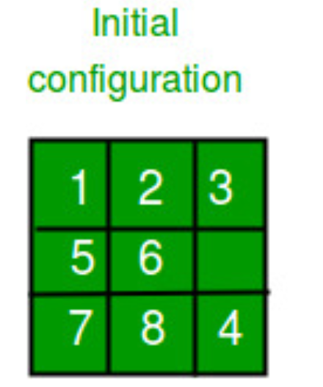
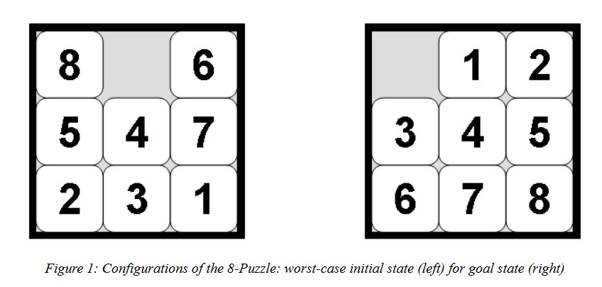
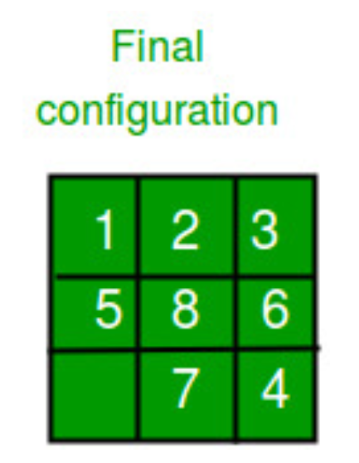
8 puzzle problem
Given a 3×3 board with 8 tiles (every tile has one number from 1 to 8) and one empty space. The objective is to place the numbers on tiles to match final configuration using the empty space. We can slide four adjacent (left, right, above and below) tiles into the empty space.

Slide 5
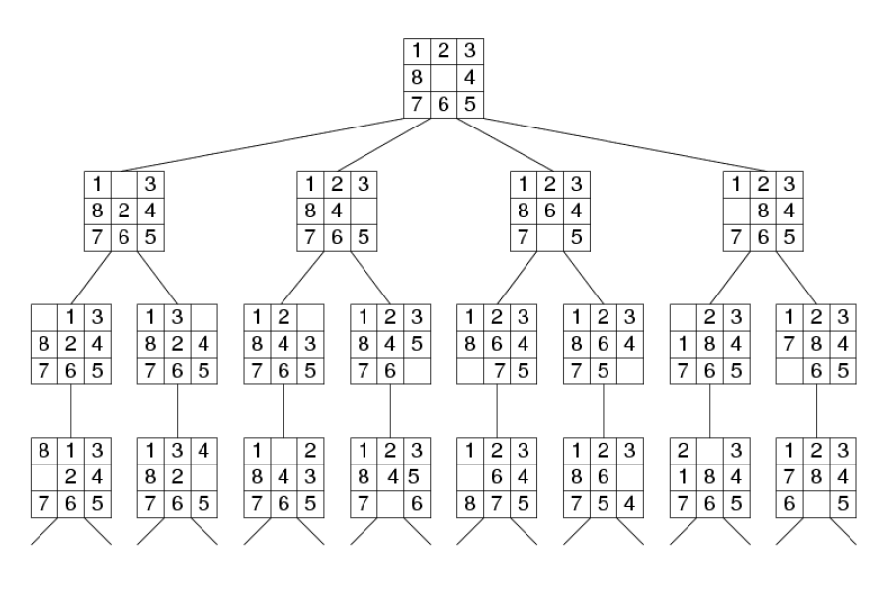

Slide 6
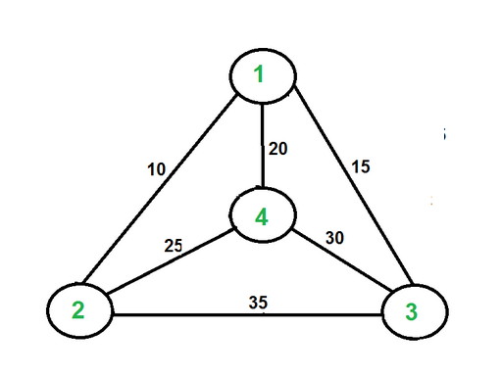
Travelling Salesman Problem (TSP)
Given a set of cities and distance between every pair of cities, the problem is to find the shortest possible route that visits every city exactly once and returns to the starting point.
For example,
consider the graph shown in figure on right side.
A TSP tour in the graph is 1-2-4-3-1.
The cost of the tour is 10+25+30+15 which is 80.

Slide 7
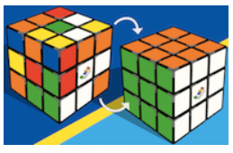
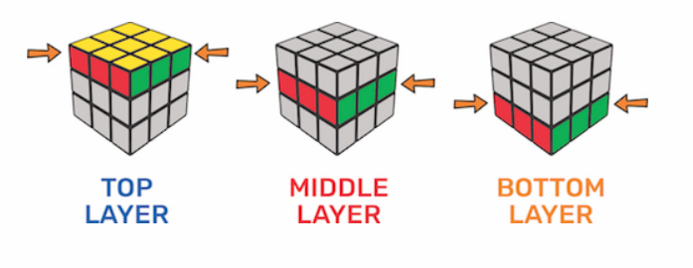
Rubik's Cube

Slide 8
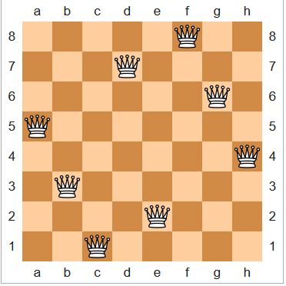
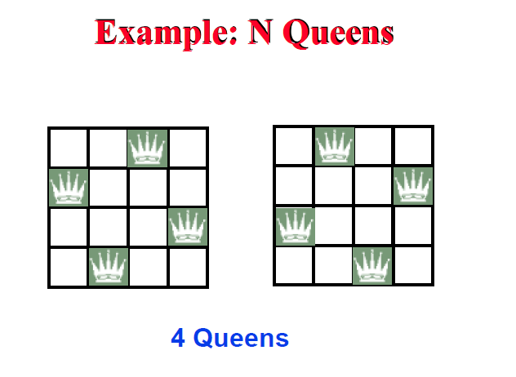
8 queen problem
The eight queens problem is the problem of placing eight queens on an 8×8 chessboard such that none of them attack one another (no two are in the same row, column, or diagonal). More generally, the n queens problem places n queens on an n×n chessboard.

Slide 9
Searching for a Solution
This problem can be solved by searching for a solution, which is a sequence of actions (tile moves) that leads from the initial state to the goal state.
Two possible states of the 8-puzzle are shown in figure 1. The state on the right is a typical goal state. The state on the left is a configuration that represents a worst case: transforming this state into the goal state requires at least 31 actions, which is the diameter of the search space. For search algorithms the problem is often to find the shortest solution, that is, one which consists of the least number of tile moves.

Slide 10
Search Terminology
Problem Space − It is the environment in which the search takes place. (A set of states and set of operators to change those states)
Problem Instance − It is Initial state + Goal state.
Problem Space Graph − It represents problem state. States are shown by nodes and operators are shown by edges.
Depth of a problem − Length of a shortest path or shortest sequence of operators from Initial State to goal state.
Space Complexity − The maximum number of nodes that are stored in memory.
Time Complexity − The maximum number of nodes that are created.
Admissibility − A property of an algorithm to always find an optimal solution.
Branching Factor − The average number of child nodes in the problem space graph.
Depth − Length of the shortest path from initial state to goal state.

Slide 11
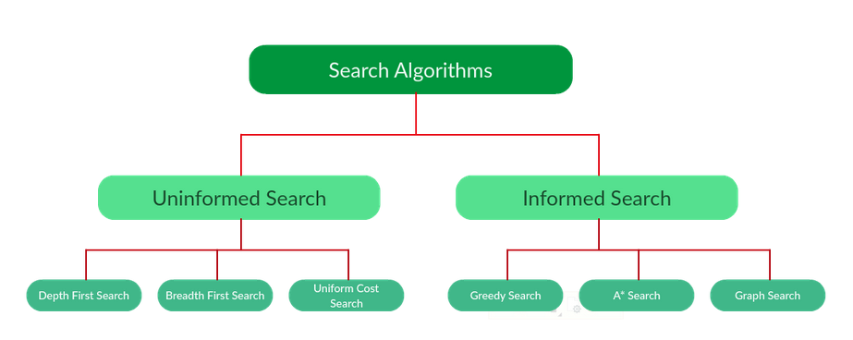
Types of search algorithms

Slide 12
Uninformed Search Algorithms
The search algorithms in this section have no additional information on the goal node other than the one provided in the problem definition.
The plans to reach the goal state from the start state differ only by the order and/or length of actions.
Uninformed search is also called Blind search.

Slide 13
Uninformed Search Algorithms
The following uninformed search algorithms are discussed in this section.
Depth First Search
Breath First Search

Slide 14
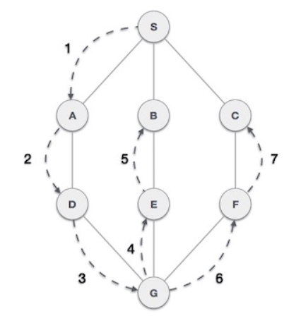
Depth First Search
Depth First Search (DFS) algorithm traverses a graph in a depthward motion and uses a stack to remember to get the next vertex to start a search, when a dead end occurs in any iteration.
As in the example given above, DFS algorithm traverses from S to A to D to G to E to B first, then to F and lastly to C.
It employs the following rules.
Rule 1 − Visit the adjacent unvisited vertex. Mark it as visited. Display it. Push it in a stack.
Rule 2 − If no adjacent vertex is found, pop up a vertex from the stack. (It will pop up all the vertices from the stack, which do not have adjacent vertices.)
Rule 3 − Repeat Rule 1 and Rule 2 until the stack is empty.

Slide 15
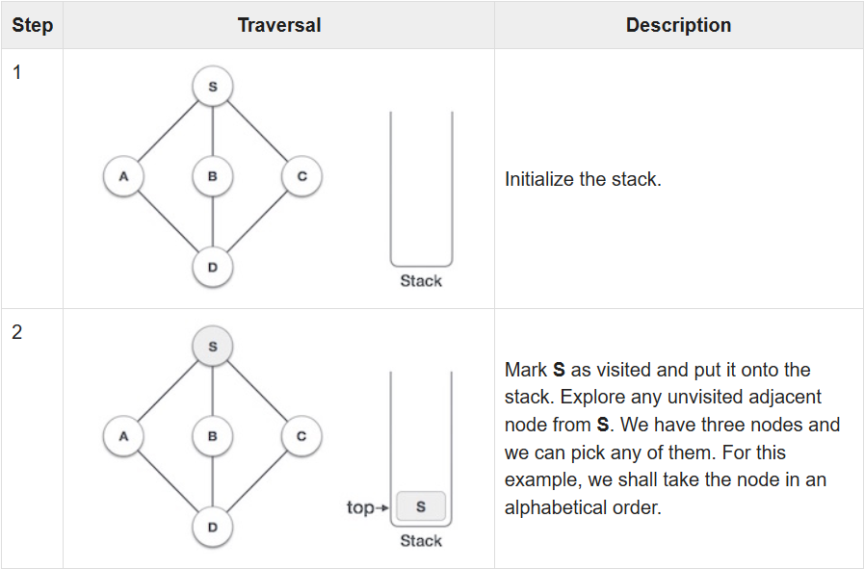
Depth First Search

Slide 16
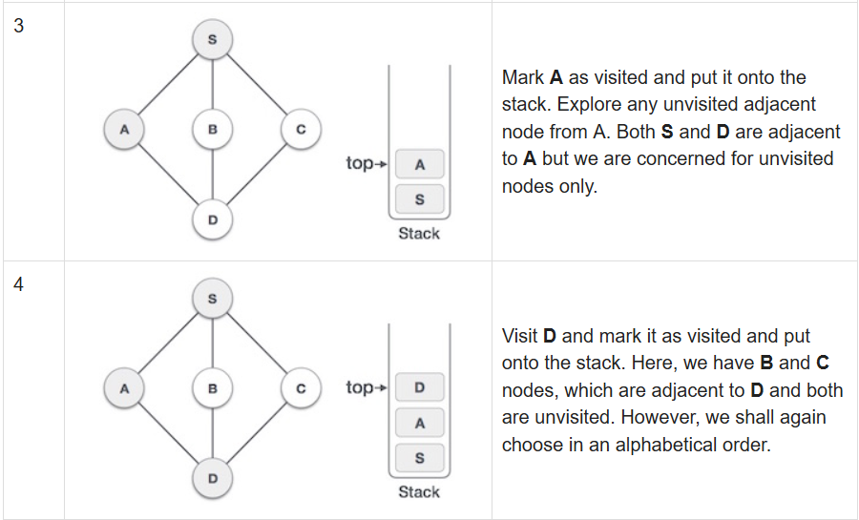
Depth First Search

Slide 17
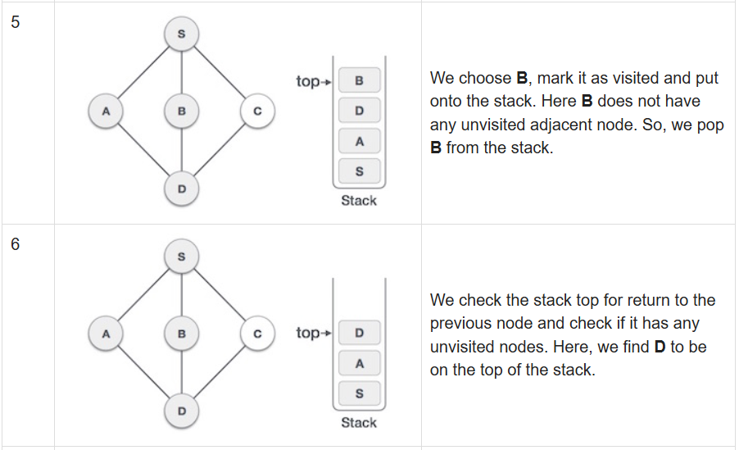
Depth First Search

Slide 18
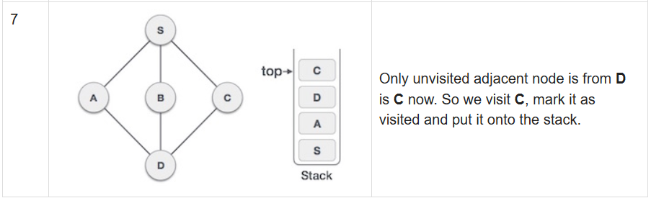
Depth First Search
As C does not have any unvisited adjacent node so we keep popping the stack until we find a node that has an unvisited adjacent node. In this case, there's none and we keep popping until the stack is empty.

Slide 19
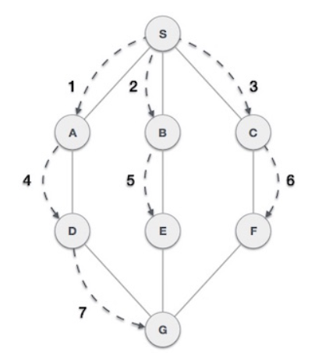
Breadth First Search (BFS)
Breadth First Search (BFS) algorithm traverses a graph in a breadthward motion and uses a queue to remember to get the next vertex to start a search, when a dead end occurs in any iteration.
As in the example given above, BFS algorithm traverses from A to B to E to F first then to C and G lastly to D.
It employs the following rules.
Rule 1 − Visit the adjacent unvisited vertex. Mark it as visited. Display it. Insert it in a queue.
Rule 2 − If no adjacent vertex is found, remove the first vertex from the queue.
Rule 3 − Repeat Rule 1 and Rule 2 until the queue is empty.

Slide 20
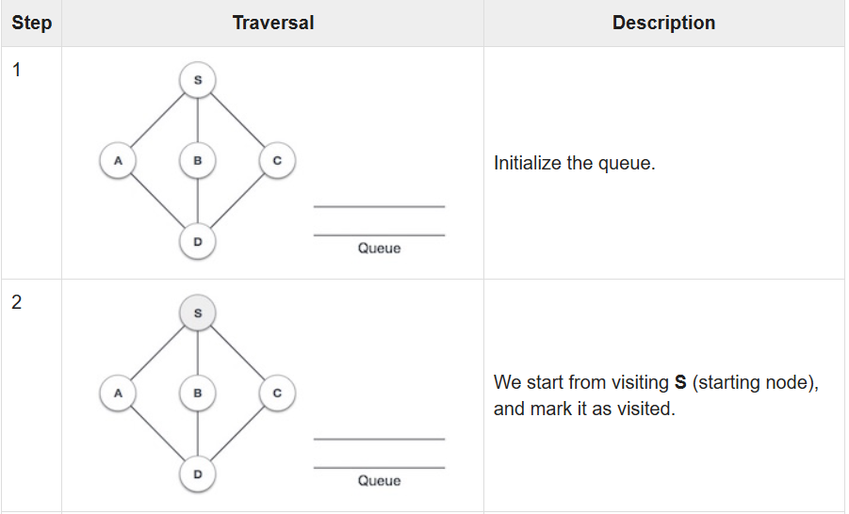

Slide 21
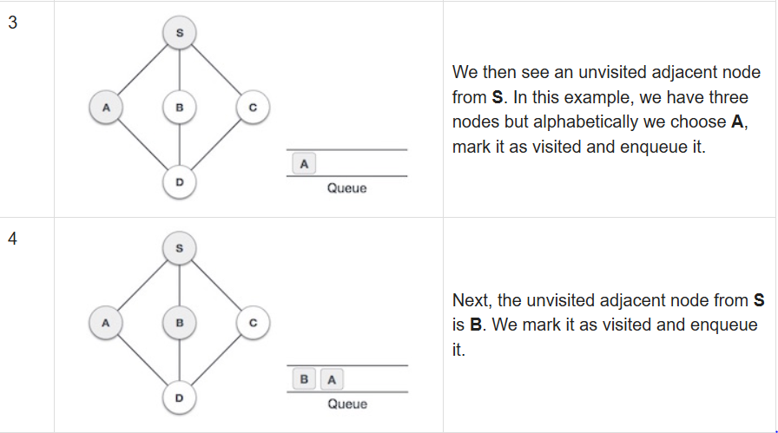

Slide 22
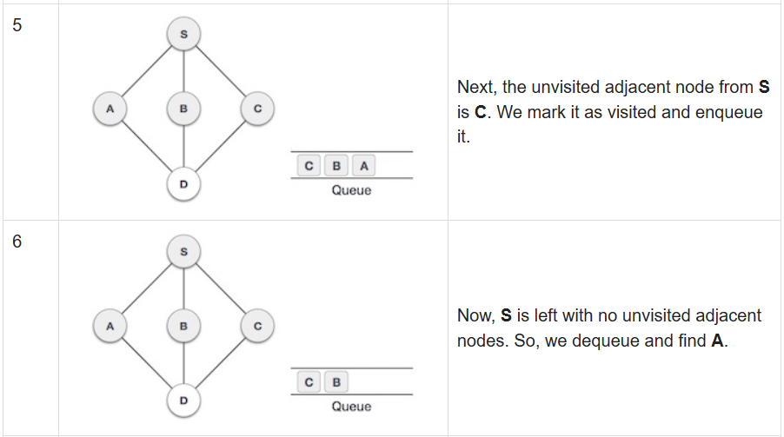

Slide 23
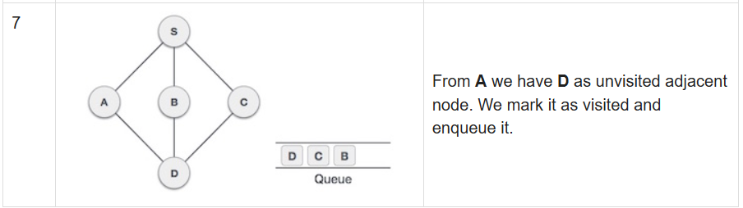
At this stage, we are left with no unmarked (unvisited) nodes. But as per the algorithm we keep on dequeuing in order to get all unvisited nodes. When the queue gets emptied, the program is over.

Slide 24
References:
https://www.geeksforgeeks.org/search-algorithms-in-ai/
https://www.tutorialspoint.com/data_structures_algorithms/breadth_first_traversal.htm
http://www.aiai.ed.ac.uk/~gwickler/eightpuzzle-uninf.html
https://www.tutorialandexample.com/heuristic-functions/

